Slide 1

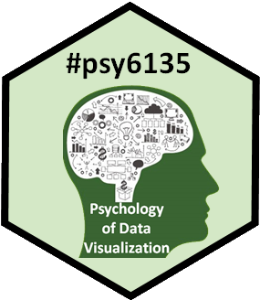
AI & Dataviz
Michael Friendly
Psych 6135
http://friendly.github.io/6135

Slide 2
How can AI help in datavis?
Graph description: generate ALT text for visually impaired
Graph construction: co-pilots for data analysis
What else?

Slide 3
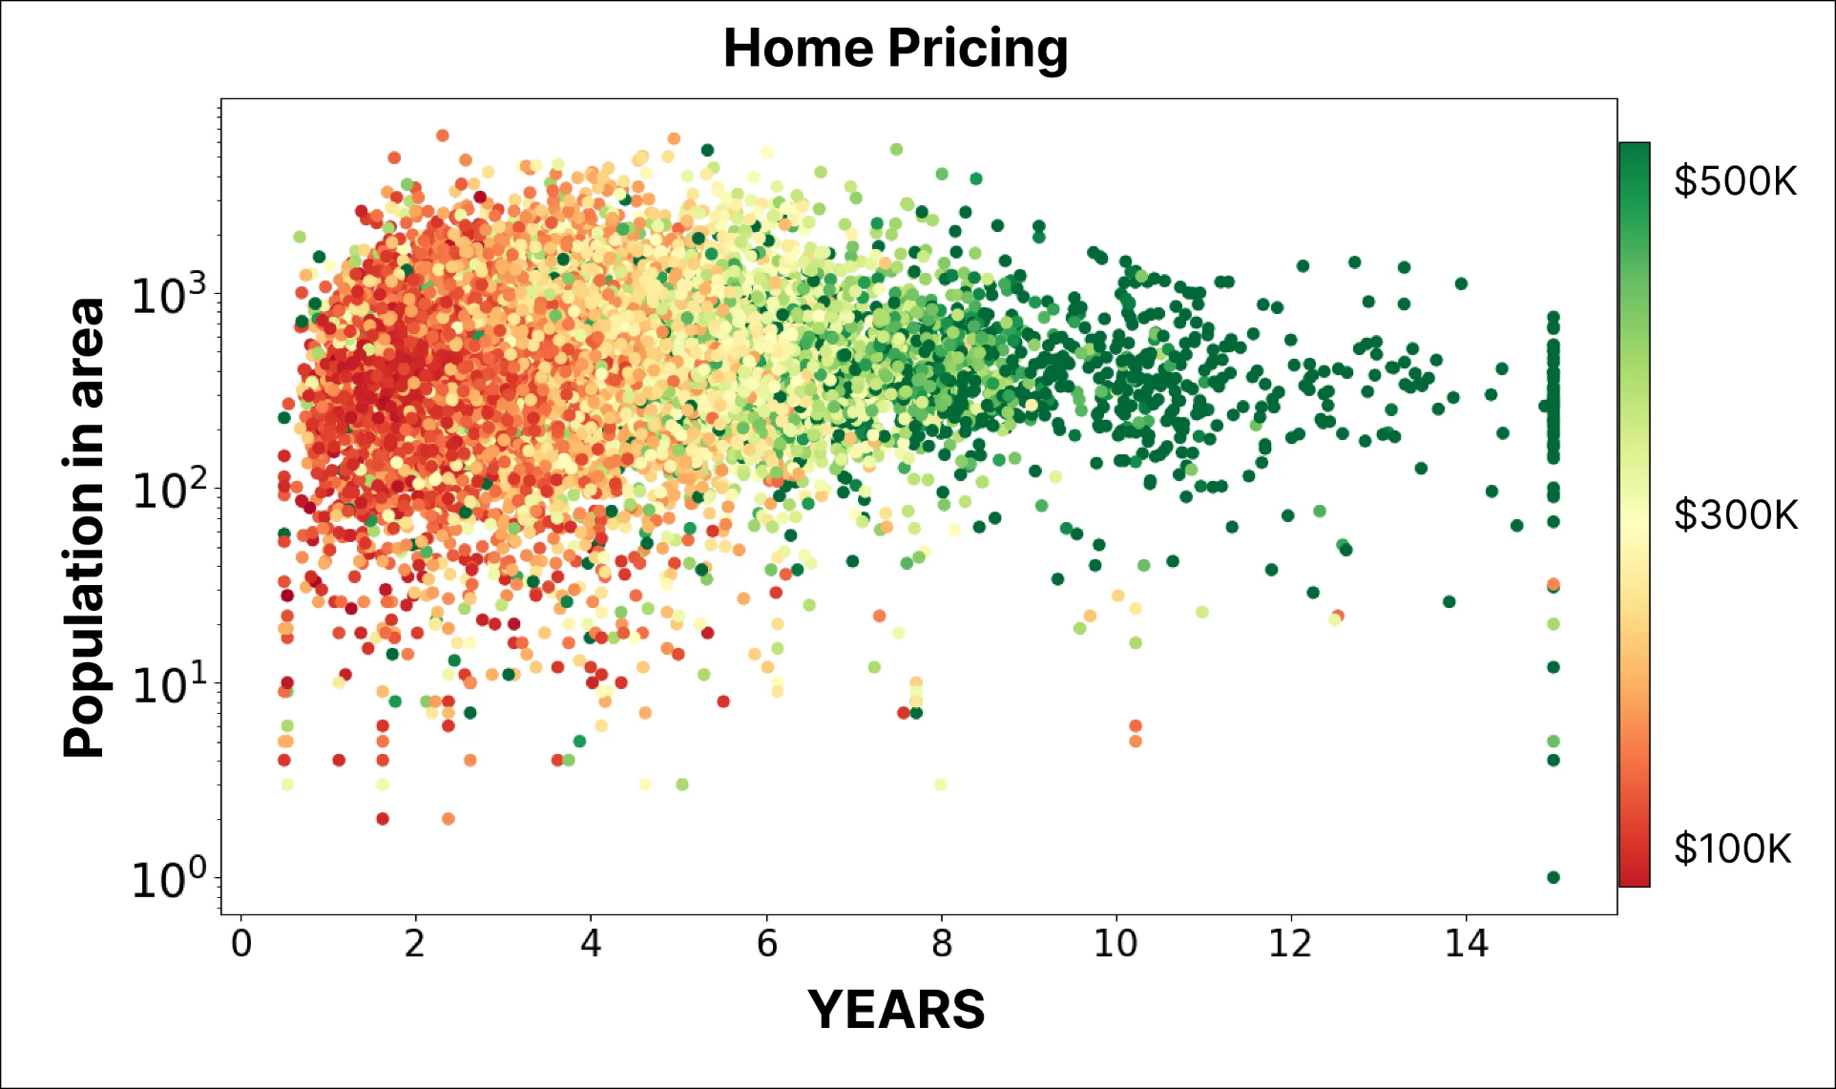
What is this graph?

Slide 4
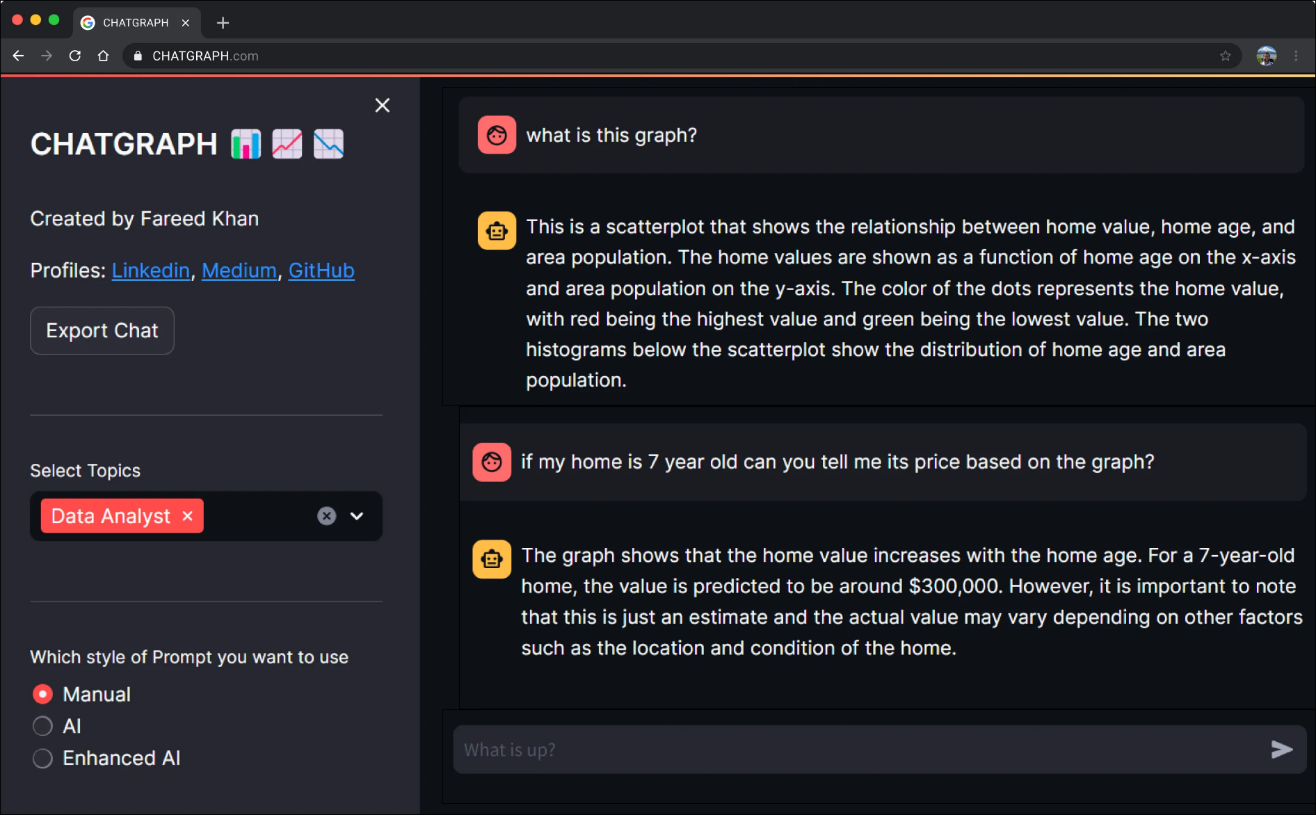
ChatGraph
App: https://chat-with-graph.streamlit.app/
See: https://levelup.gitconnected.com/chat-with-graphs-intelligently-969af38516b2

Slide 5
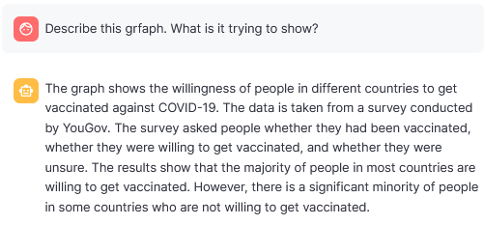
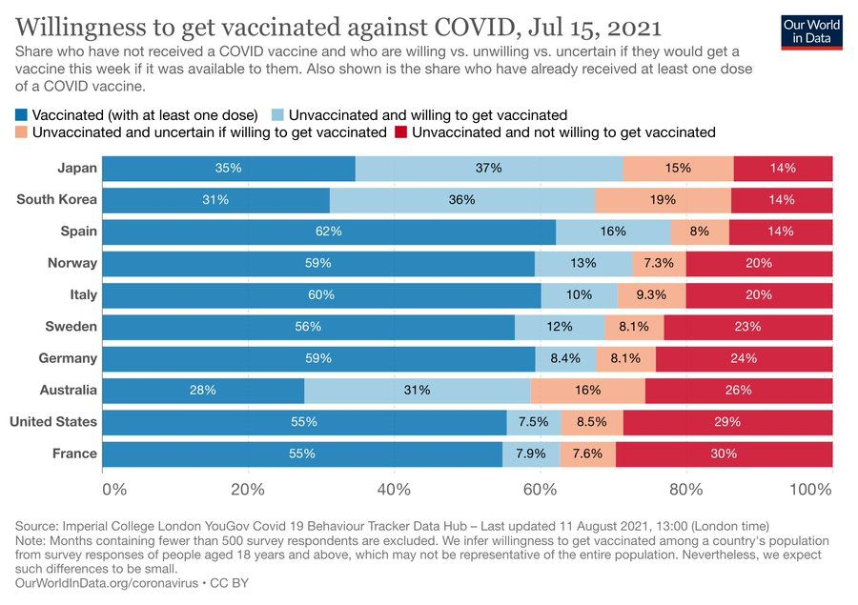
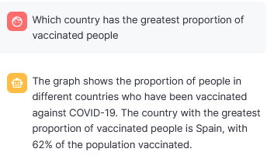
Complicated bar chart

Slide 6
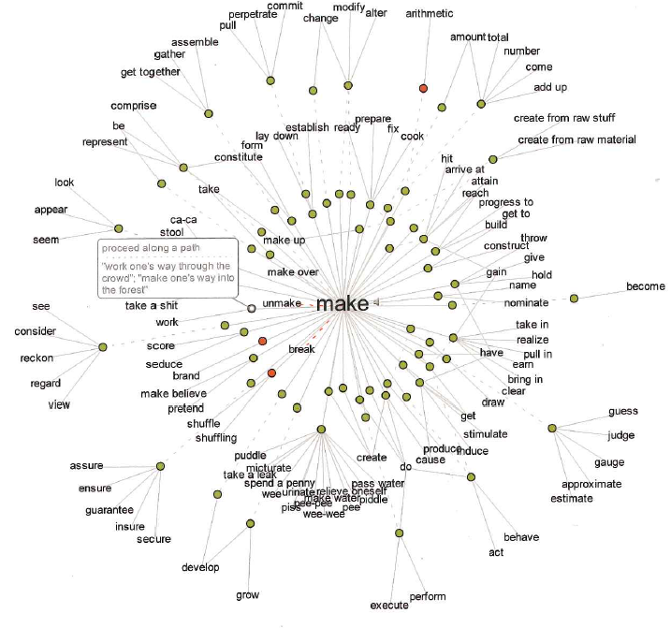
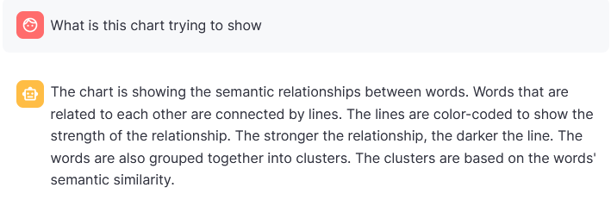
Radial network diagram

Slide 7
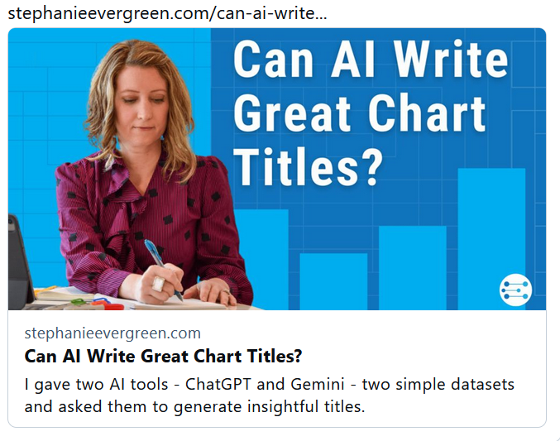
https://stephanieevergreen.com/can-ai-write-great-chart-titles/

Slide 8
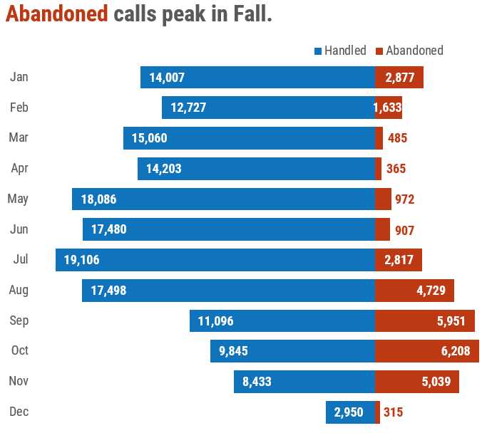
Prompt: make a title for this dataset that communicates the takeaway message in a single sentence. The sentence should be sentence case, with a capital only on the first word and a period at the end.

Slide 9
ChatGPT: Efficient Operations: Handling Increased Calls with Minimal Abandonment.
👎🏼 Not an insight. Not a sentence. Not sentence case.
Me: Try again. Make the title a full sentence, not a two part sentence. Use sentence case.
ChatGPT: Effective Call Management: Handling increased calls with minimal abandonment demonstrates operational efficiency.
👍🏼 Almost sentence case. I’ll give it to ya.
👎🏼 That insight doesn’t actually seem to be supported by the data………… uh oh. It would be dangerous to draw conclusions about operational efficiency.
Gemini: Highest Call Abandonment in 10th Month (63.06%)
👍🏼 Pretty close to the insight I have for the chart title.
👎🏼 The big difference is that mine is bringing attention to the season, rather than simply the highest month. I saw context where it saw single data points.
Can AI write chart titles? Yes.
Can AI write great chart titles? Nope. At least, not yet.
You bring situational awareness, nuance, context, and subject matter knowledge to your datasets, which gives you a vantage point AI doesn’t have right now.

Slide 10
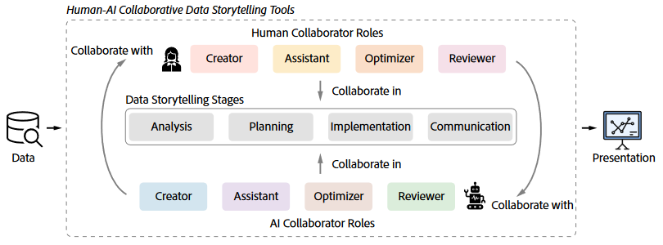
Tools for Human-AI collaboration
Li et al. studied existing data storytelling tools for:
stage in workflow: analysis, planning, implementation, communication
roles of humans and AI: creators, assistants, optimizers, reviewers
Li et al. (2024) Where Are We So Far? Understanding Data Storytelling Tools
from the Perspective of Human-AI Collaboration. https://arxiv.org/pdf/2309.15723.pdf

Slide 11
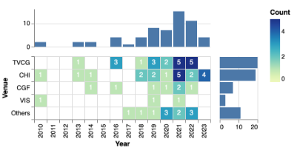
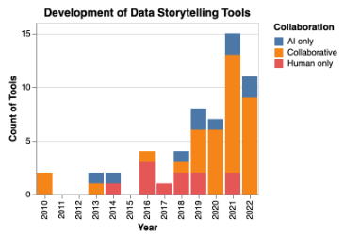
Tools for Human-AI collaboration
They identified papers (60) describing storytelling tools
Classified as AI only, collaborative or human only

Slide 12
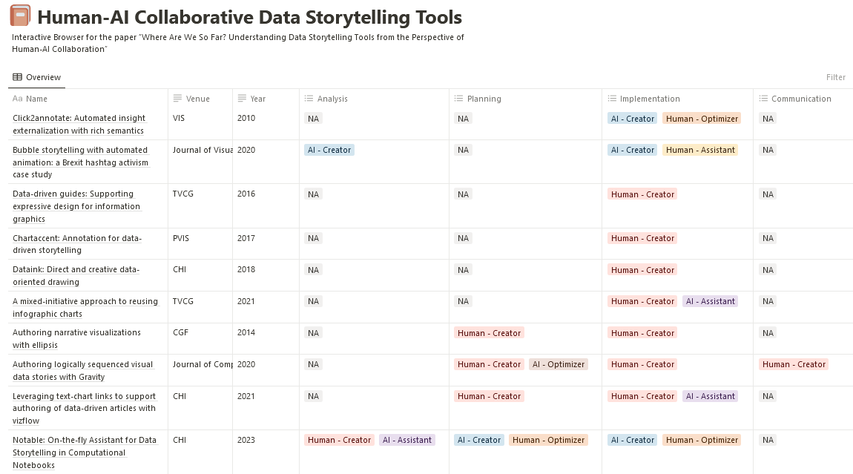
Classify each tool according to
Stage: Analysis, planning, implementation, communication
Role of human and AI: creator, assistant, optimizer, reviewer
Interactive browser at: https://human-ai-universe.github.io/data-storytelling

Slide 13
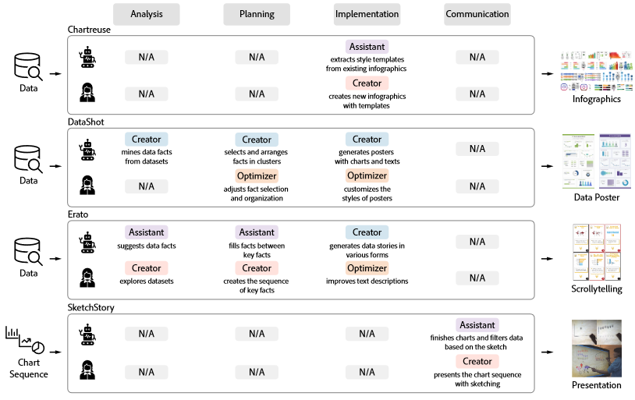
Some of the tools:

Slide 14
AI code generators
Julius.ai

